Slide 1
Subtype Identification and Clustering of single-cell RNA-seq data by nearest neighbor searching
Zhixin Li
July 13, 2018
Notes:
Module-based

Slide 2
Overview
Current clustering methods for scRNAseq and limitations
Hypothesis and Inspiration
Algorithm of MSIC
Performance on simulated dataset
Application in real cases
Conclusions

Slide 3
Clustering and the role of marker
Heterogeneity (developmental/pathogenic mechanism)
Before scRNA-seq:
Morphology
Surface protein
Marker gene: uniquely/highly expressed gene for certain cells.
Cell identity: marker can reliably distinguish between two or more clusters.
Crucially, marker genes can be used for experimental validation.
Marker genes may also be used for in situ imaging of the putative cell population.

Slide 4
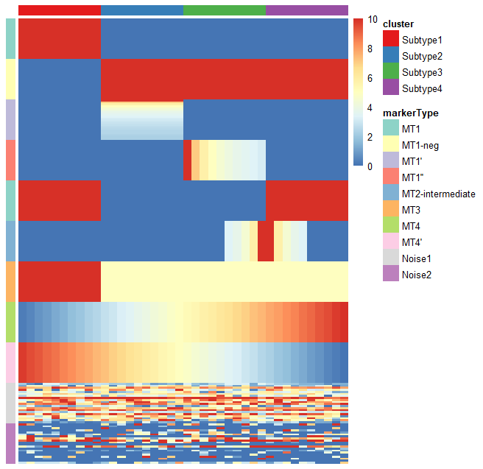
Simulated data
Marker types (MTs)
MT1 – uniquely expressed genes with the same expression level
MT1-neg – negative markers of MT1
MT1’ – uniquely expressed genes with different expression levels
MT1’’ – uniquely expressed genes synergistic change across cells
MT2- intermediate – intermediate genes between two subtypes
MT3 – highly expressed genes in certain subtypes
MT4 – genes with gradually rising/falling expression
Biological insights
Genes
Cells
Notes:
However, there is also a large amount of technical and biological noise. Because of the low number of RNA transcriptomes and the stochastic nature of the gene expression pattern, there is a high chance of missing nonzero entries as zero, which are called dropout events.

Slide 5
Current clustering method and their limitations
SC3 (Kiselev et al., Nature Methods 2017) is based on PCA and spectral dimensionality reductions.
SIMLR (Wang et al., Nature Methods 2017) is a kernel-based similarity learning method.
Seurat (Butler et al., Nature Biotechnology 2018) is a community detection approach similar to SNN-Cliq
T-SNE + k-means (10x Genomics official method)
SINCERA (Guo et al., 2015) is based on hierarchical clustering
pcaReduce (žurauskienė and Yau, 2016) combines PCA, k-means and “iterative” hierarchical clustering.
SNN-Cliq (C. Xu and Su, 2015) is a graph-based method.
Limitations:
Need to choose a k for clustering
Need to do feature selection before clustering
Can’t avoid some confounding genes (cell cycle, apoptosis)
Consume a lot of computing resources

Slide 6
Inspiration
New strategy for scRNA-seq clustering
Correlation between the genes in the same marker module is higher.
Can we identify all the marker modules first and then using them to do the clustering?
Notes:
Add dropout rate, then show the correlation heatmap

Slide 7
Hypothesis
marker modules locate in the local centers (gene clusters with high density) in the gene-gene correlation network.
Then marker module identification is a question of local center identification.
Slicing and scanning method can effectively detect the local center of a network.
Nearest neighbor search can be used for full marker module identification.
Subtypes can be inferred by the marker modules.
Notes:
How to show gene-gene network, hclust
Or show pca plot of genes

Slide 8
MSIC overview
Cell outlier detection
Build gene-gene correlation network
Identify local centers of the network
Identify full marker modules by nearest searching
Classify the marker modules
Infer the subtypes

Slide 9
Outlier
Classical version: observations lying “far away” from the main part of a dataset and probably not following the assumed model (Becker and Gather, 1999).
Single cell version: cells far away from any subgroups in a heterogeneous cell population. p >> n (p denotes feature count, n denotes sample size).
Purpose: removing the extreme outliers far away from any cells and keep the rare cell populations.
Notes:
Correlation is the basic for further analysis.
Correlation, especially Pearson correlation, is very sensitive to strong outliers.
Make a cartoon plot to show the difference.
Why need dimension reduction?
Why current method can not be used?
How my method can detect if there is a outlier?

Slide 10
Notes:
Show the necessary for outlier detection
Quantify the effect of outlier
Few outlier will not affect the correlation
Show why spearman is better than pearson
Conclusion: extreme outlier will seriously affect the correlation between markers.

Slide 11
Extreme Outlier detection
Method: dimension reduction (PCA) + Kth nearest neighbors
dimension reduction: remove noisy features
Kth nearest neighbors: keep rare cell populations
Use a cartoon plot to show the algorithm
Notes:
why removing outlier is necessary? using simulated data to explain this point
why current outlier detection method is not suitable? use ground truth to demonstrate this point, compare different tools (removing the rare populations)
why using dimension reduction (cite paper)? top 100 or 95% explained variance PCs
try different dimension reduction method (PCA and DM), compare the results
outlier detection algorithm, minNum

Slide 14
deng
pollen

Slide 15
Effect of outliers on correlation
Add outliers, check correlation.
How to judge the exist of outlier?
How our method can keep rare population.

Slide 16
Local center identification

Slide 17
Nearest neighbors searching

Slide 18
Subtypes inference

Slide 19
Performance on simulated dataset
Show what result can we get
Finally, we will get all the marker modules, and the sum expression plot.
Clustering inference can be made.
Notes:
To compare two sets of clustering labels we can use adjusted Rand index. The index is a measure of the similarity between two data clusterings. Values of the adjusted Rand index lie in [0,1] interval, where 1 means that two clusterings are identical and 0 means the level of similarity expected by chance.

Slide 20
Performance on real dataset
Smart-seq:
100-1000 cells
3k-10k expressed genes
Low dropout rate
10x genomics
1k-10k cells
500-3000 expressed genes
High dropout rate

Slide 21
Co-expresssion network analysis
Improvements

Slide 22
Time consumption comparison

Slide 23
Key advantages - conclusion
No need to choose a k for clustering
No need to do feature selection
Can identify negative markers
Can identify the intermediate subgroup
Can identify rare subgroup
Greatly reduce the computing resource (at least 10 folds)
More intuitive strategy
Great benefit for downstream analysis

Slide 24
To do
Write a paper
Write a R package (submit to Bioconductor)

